Slide 1
Energy Production and Reserves: Present and Future
Salwinder Gill & Batbileg Enkhbat

Slide 2
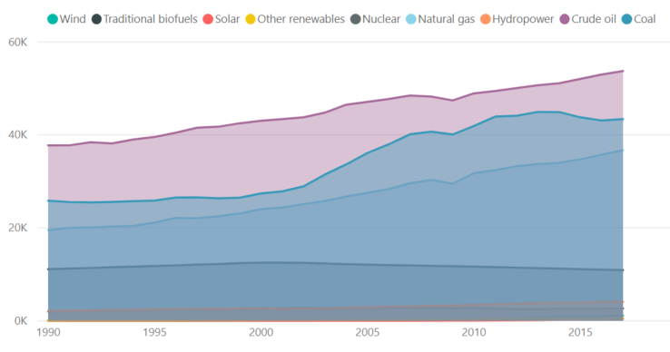
Energy Production
Energy Production refers to forms of primary energy - Petroleum (crude oil, natural gas liquids, and oil from non conventional sources), Natural Gas, Solid Fuels (Coal, Lignite, and Other derived fuels), and combustible renewables and waste
All converted into tonnes of oil equivalents (toe).

Slide 3
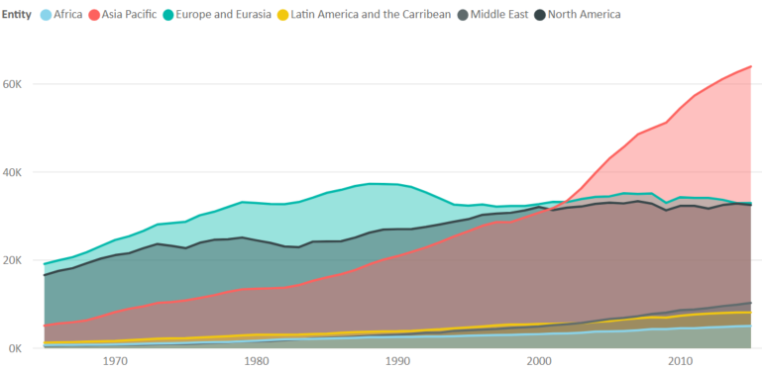
Energy Consumption Per Region
Asia Pacific is the largest consumer 43%
North America and Europe 16% each
Middle East, Latin America and Africa 7 % each

Slide 4
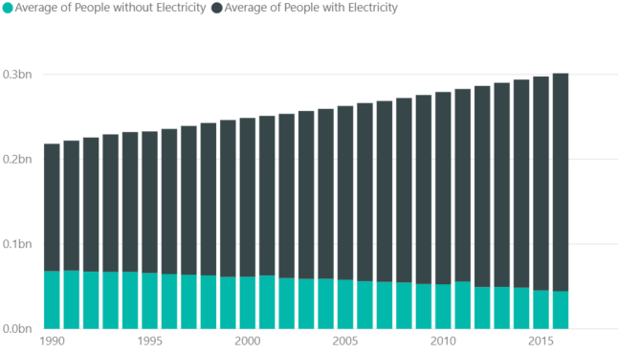
People with access to Electricity
With increasing Population, number of people without electricity has declined
Number of People with access to electricity has increased to 2.7 billion

Slide 5
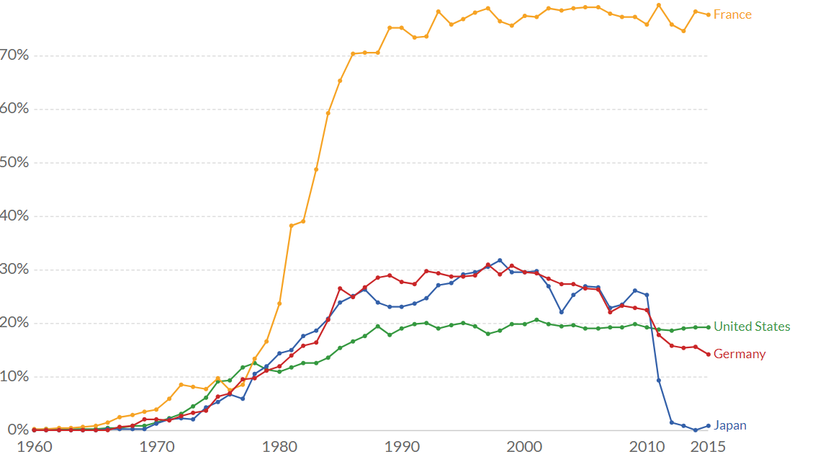
Nuclear EnergyProduction
The Share of Nuclear Production has decreased by more than 6 %
Almost every country has reduced production of Nuclear Energy as it is very dangerous to human beings.

Slide 6
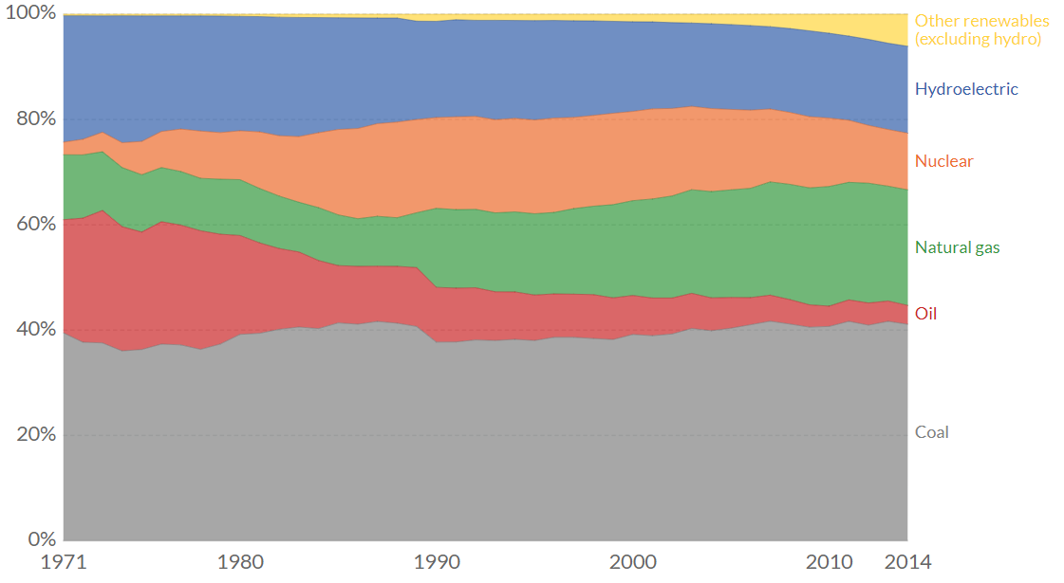
Energy Generation by Source
The Share of Renewable source of energy has increased by more than 6 %
The Share of Nuclear Production has decreased by the same amount ( 6 %)
Contribution from oil has declined by 10%
There is almost no change in total share of coal energy

Slide 7
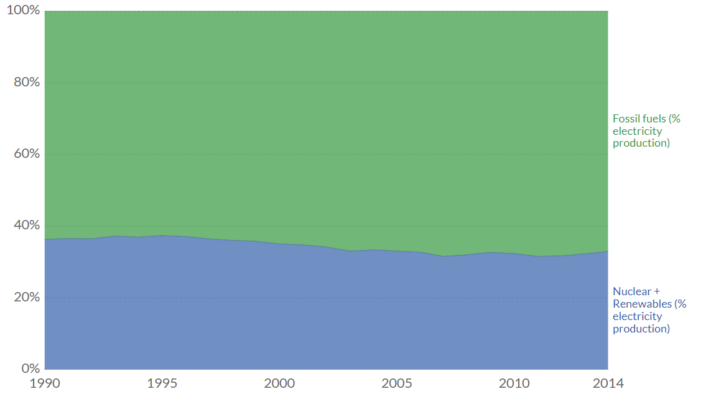
Fossil fuels & low-carbon sources
Total share of low-carbon electricity production is almost exactly the same as a decade ago

Slide 8
Conclusion
If we want to reduce our global greenhouse gas emissions, the world has to transition from an energy system dominated by fossil fuels to a low-carbon one
We have two options to achieve this: Renewable technologies (including bioenergy, hydropower, solar, wind, geothermal, and marine energy) and Nuclear energy.
Both of these options produce very low CO2 emissions per unit of energy compared with fossil fuels. This is called ‘Decarbonisation'

Slide 9
World population
12
12
10
There will be roughly 12 billion
people by 2100
8
6
4
2
1950
2000
2050
2100

